Slide 1



CARBON CAPTURE
WEEK 2
Different Types of Carbon Capture Technology and processes.

Slide 2

Let's spell it out!
TOPIC OUTLINE
Chemical Looping Combustion
Solid Oxy Fuel Cell
ZEG
Hydrogen Membrane Reactor

Slide 3


DAY - 4
Future Technologies in Carbon Capture

Slide 4

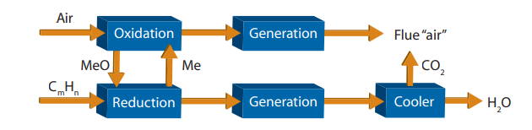
CHEMICAL LOOPING COMBUSTION (CLC)
This process utilizes pure oxygen for combustion by employing metals that bind oxygen from the air. Two separate reactors are involved: in the first reactor, metal reacts with oxygen at 400-500°C under pressure, forming metal oxide. The metal oxide is then transported to a second reactor, where it releases oxygen at 500-900°C through a reaction with natural gas. The metal is recycled back to the first reactor. Alternatively, each reactor can alternate roles, supplying air and fuel as needed. Exhaust gas from the reactor passes through a turbine to generate power. CO2 is separated by cooling and condensing water from the exhaust gas. Additional power may be generated from the warm oxygen-lean air from the oxidation process.
Research on this technology is being conducted at the Norwegian University of Science and Technology and Chalmers University of Technology in Sweden.

Slide 5
In chemical looping combustion using carbon as the fuel, the primary reaction proceeds as follows:
C(s) + 2 MexOy(s) → CO2(g) + 2MexOy-1(s)
Following the fuel oxidation/carrier reduction step, the spent carrier is regenerated in a carrier oxidation reactor via:
2MexOy-1(s) + O2(g) →2 MexOy(s)
This reactor replaces the conventional gas turbine combustion chamber, capturing oxygen directly from the air and eliminating the need for a separate air separation unit. The metal carrier oxidation can be exothermic (for Cu, Mn, or Ba) or endothermic (for Fe and Ni), whereas the carrier reduction step is always exothermic.
Development work has used metal oxide carriers typically in the form of particles with diameters of 100–500 μm, sometimes supported on alumina (e.g., Ni). These reactions occur in two fluidized bed reactors, ensuring efficient heat and mass transfer. Recycling solid carriers between the reactors is crucial for maintaining operating temperatures and overall heat balance, posing significant technological challenges. For instance, the BaO2/BaO loop requires 20 kg of BaO2 per kg of carbon, and applying this carrier to generate supercritical steam for a 500 MWe power plant would necessitate a carrier transport rate of 103 t/s (3.6 Mt/h).

Slide 6

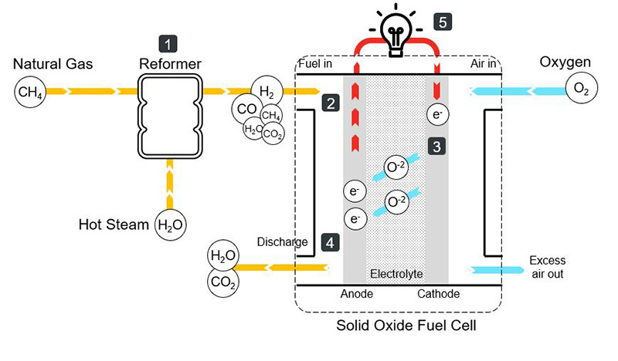
SOLID OXY FUEL CELL
Solid oxide fuel cells (SOFCs) operate at very high temperatures, requiring ceramic materials to reach up to 1000°C for adequate conductivity. These fuel cells enable more efficient power production compared to combustion by facilitating the electrochemical oxidation of gaseous fuels to directly produce electricity. SOFC technology offers power generation efficiency of about 48-50%, with an unreacted fuel stream of around 15% that can fuel an afterburner for additional power generation in a turbine, potentially achieving 60-70% efficiency. These systems leverage the internal reforming capabilities of high-temperature fuel cells, decomposing natural gas into hydrogen and CO2 through a reforming process with water at 600-800°C. The hydrogen produced can then be used in a gas turbine or fuel cell to generate electricity.

Slide 7
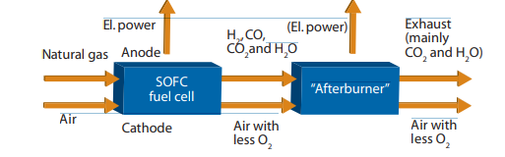
A solid oxide fuel cell utilizes the movement of electrons and generates electricity in a few basic steps.
Natural gas goes through a steam-reforming process. This chemical reaction produces hydrogen (H₂), carbon monoxide (CO), carbon dioxide (CO₂), and steam (H₂O). There will be some unreformed natural gas left in the mix as well.
The mix of elements from the reformer enters the fuel cell at the anode side. Meanwhile, air (including oxygen) enters the fuel cell at the cathode side.
Oxygen in the air combines with free electrons to form oxide ions at the cathode. Oxide ions with free electrons travel from the cathode to the anode through the electrolyte.
At the anode, oxide ions react with hydrogen forming water (steam) and with carbon monoxide (CO) forming carbon dioxide (CO₂).
Reactions covered on Step #4 release free electrons. These free electrons travel to the cathode through the external electrical circuit, producing electricity.

Slide 8
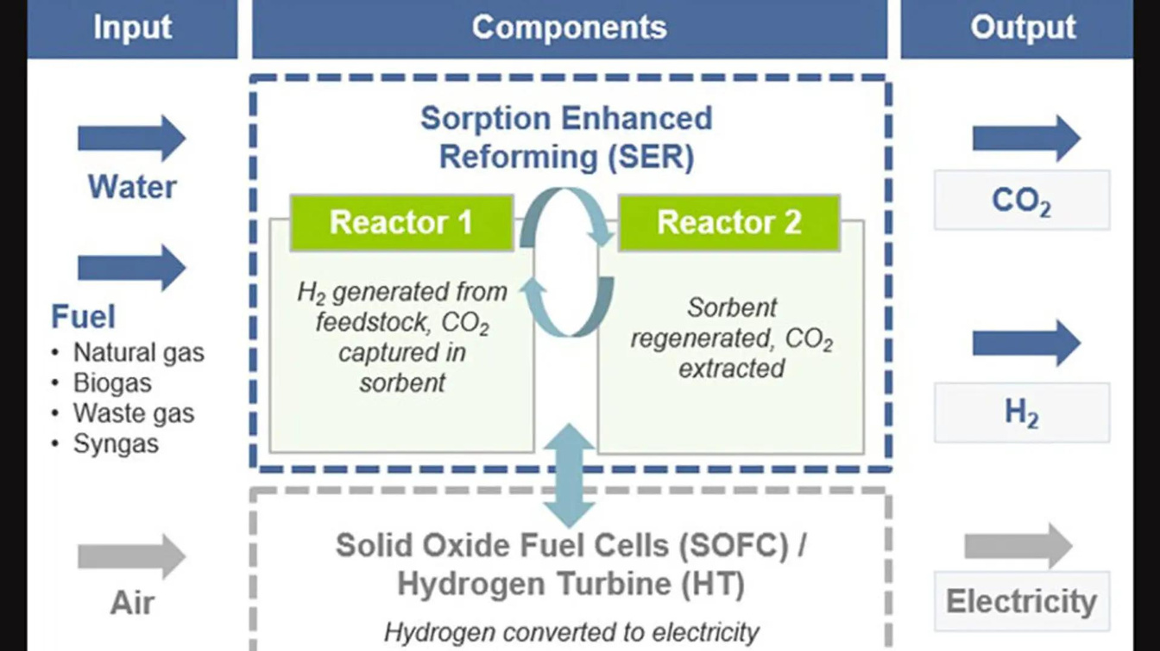
ZEG
The Norwegian Institute for Energy Technology (IFE) is developing a process for CO2 capture using calcium carbonate at high temperatures integrated with a SOFC. In a joint venture with Christian Michelsen Research (CMR) and Prototech, IFE is conducting lab tests on combined power and hydrogen production with carbon capture, called ZEG (Zero Emission Gas Power Project). Here, natural gas is reformed to hydrogen and CO2 in a reactor at high temperature. Calcium oxide is supplied, reacting with the CO2 to form calcium carbonate. Heat from the fuel cell is used to separate CO2 from the carbonate. Regenerated calcium oxide is recycled and used to capture more CO2 . The process produces both electricity and hydrogen.

Slide 9
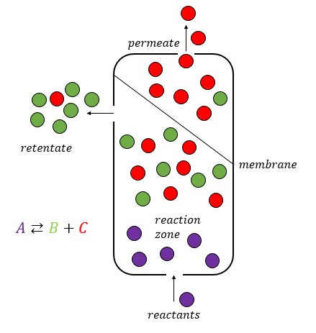
HYDROGEN MEMBRANE REACTOR
In hydrogen membrane reactors hydrogen is produced using a membrane that separates hydrogen from a given gas mixture. This reaction is therefore more complete than in conventional reactors, and the technology can improve efficiency of pre-combustion carbon capture. With this membrane natural gas and steam is transported through a pipe filled with small spheres of catalytic material. CO and H2 are formed in the reforming process, through which hydrogen is continuously tapped through the pipe wall. The reaction is more complete and can take place at a lower temperature with lower steam surplus and at a higher pressure – all in all reducing the energy loss. However, acquiring adequate materials and a practical design for integrated high temperature membranes is very difficult.

Slide 10
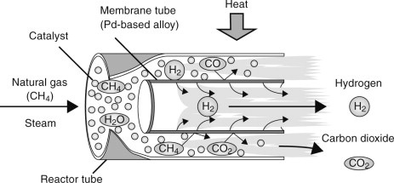
To be suitable for the hydrogen production industry, membranes must have a high flux, high selectivity towards hydrogen, low cost and high stability. Among membranes, dense inorganic are the most suitable having a selectivity orders of magnitude bigger than porous ones. Among dense membranes, metallic ones are the most used due to higher fluxes compared to ceramic ones.
The most used material in hydrogen separation membranes is palladium, particularly its alloy with silver. This metal, even if it is more expensive than other ones, shows very high solubility towards hydrogen.
The transport mechanism of hydrogen inside palladium membranes follows a solution/diffusion mechanism: hydrogen molecule is adsorbed onto the surface of the membrane, then it is split into hydrogen atoms; these atoms go across the membrane through diffusion and then recombine again into hydrogen molecule on the low-pressure side of the membrane; then, it is desorbed from the surface. In recent years, several works were performed to study the integration of palladium membranes inside fluidized bed membrane reactors for hydrogen production.

Slide 11
THANK YOU

